Slide 1
MemReprise
Medium-Fi Prototype
Casey, Caroline, Kayla, Sophie

Slide 2




Team
Kayla Patterson
Sophie Wu
01
MSCS ‘24
New Jersey
03
BSCS ‘24, MSCS ‘25
Minnesota
Casey Nguyen
Caroline Tran
02
BSCS ‘23, MSCS ‘25
Washington
04
BSCS ‘24, MSCS ‘24
California

Slide 3
Outline
01
04
02
05
03
06
07
08
Value Proposition
Tasks
Problem/Solution
Usability Goals
Values in Design
Major Design Changes
Med-Fi Task Flows
Implementation

Slide 4
Title
MemReprise
“Where Music and Memories Meet”
01
Value Proposition

Slide 5
Problem + Solution
02

Slide 6
The Problem
The Solution
People often have deep, yet hard-to-quantify associations with their favorite music.
These associations go undocumented and unshared.
People often have deep, yet hard-to-quantify associations with their favorite music.
These associations go undocumented and unshared.
Notes:
Associations—memory, emotions

Slide 7
The Problem
The Solution
People often have deep, yet hard-to-quantify associations with their favorite music.
These associations go undocumented and unshared.
People often have deep, yet hard-to-quantify associations with their favorite music.
These associations go undocumented and unshared.
An app that prompts you daily to:
Log the song you’re currently listening to
Notes:
Associations—memory, emotions

Slide 8
The Problem
The Solution
People often have deep, yet hard-to-quantify associations with their favorite music.
These associations go undocumented and unshared.
People often have deep, yet hard-to-quantify associations with their favorite music.
These associations go undocumented and unshared.
An app that prompts you daily to:
Log the song you’re currently listening to
Associate it with a themed question
Notes:
Associations—memory, emotions

Slide 9
The Problem
The Solution
People often have deep, yet hard-to-quantify associations with their favorite music.
These associations go undocumented and unshared.
People often have deep, yet hard-to-quantify associations with their favorite music.
These associations go undocumented and unshared.
An app that prompts you daily to:
Log the song you’re currently listening to
Associate it with a themed question
Tag current mood and activity
Notes:
Associations—memory, emotions

Slide 10
The Problem
The Solution
People often have deep, yet hard-to-quantify associations with their favorite music.
These associations go undocumented and unshared.
People often have deep, yet hard-to-quantify associations with their favorite music.
These associations go undocumented and unshared.
An app that prompts you daily to:
Log the song you’re currently listening to
Associate it with a themed question
Tag current mood and activity
Discover new music by seeing how other users answered and tagged their music
Notes:
Associations—memory, emotions

Slide 11
The Problem
The Solution
People often have deep, yet hard-to-quantify associations with their favorite music.
These associations go undocumented and unshared.
An app that prompts you daily to:
Log the song you’re currently listening to
Associate it with a themed question
Tag current mood and activity
Discover new music by seeing how other users answered and tagged their music
Posting is quick and fun.
Without any extra effort, users incrementally build an archive of their favorite music, and all of the past emotions, activities, and memories associated with it.
These memories can then be shared.
Notes:
Associations—memory, emotions

Slide 12
The Problem
The Solution
People often have deep, yet hard-to-quantify associations with their favorite music.
These associations go undocumented and unshared.
An app that prompts you daily to:
Log the song you’re currently listening to
Associate it with a themed question
Tag current mood and activity
Discover new music by seeing how other users answered and tagged their music
“Oh wow, so I can have a full [play]list of what makes other people happy, export it, and listen to it all.”
Clare Chua
(Low-Fi Prototype Tester, Stanford Student)
Notes:
Associations—memory, emotions

Slide 13
Values in Design
03

Slide 14
Values
Authenticity
Intuitiveness
01
Memory logs are genuine reflections of user experiences
03
Easy-to-navigate and user-friendly interface
Inclusivity
Playfulness
02
All users feel welcome to share and explore
04
Enjoyable and engaging
user interaction
Notes:
Posting vs. Sharing
Focused on just sharing the song, were confused about the prompts—clarification/info helpful
Profile:
What does home feed represent
Discover:
People were curious, interesting and novel to associate things

Slide 15
Value-Aligned Features
Authenticity
Intuitiveness
01
Personalized memory logs with emotion and
activity tagging
03
Streamlined navigation with clear prompts and actions
Inclusivity
Playfulness
02
Range of selections to accommodate diverse user expression
04
Themed playlists and gamified memory logging
Notes:
Posting vs. Sharing
Focused on just sharing the song, were confused about the prompts—clarification/info helpful
Profile:
What does home feed represent
Discover:
People were curious, interesting and novel to associate things

Slide 16
Value Tensions
Authenticity vs. Playfulness
Inclusivity vs. Intuitiveness
Balance genuine reflection with engaging activities
Use playful elements that don't detract from authenticity of memories shared
Make app accessible to all without compromising simplicity
Design basic mode for ease of use and toggle optional settings for depth
Notes:
Note: (5-13 min) some participants took longer because they were thinking aloud more, not necessarily because
it was difficult for them
Relevant Observations: Buttons vs. tabs confusion

Slide 17
Tasks
04

Slide 18
Task Overview
Simple
Complex
Share a song on MemReprise
Create personalized playlist from songs you previously shared
Moderate
Discover music from other users who have similar music associations

Slide 19
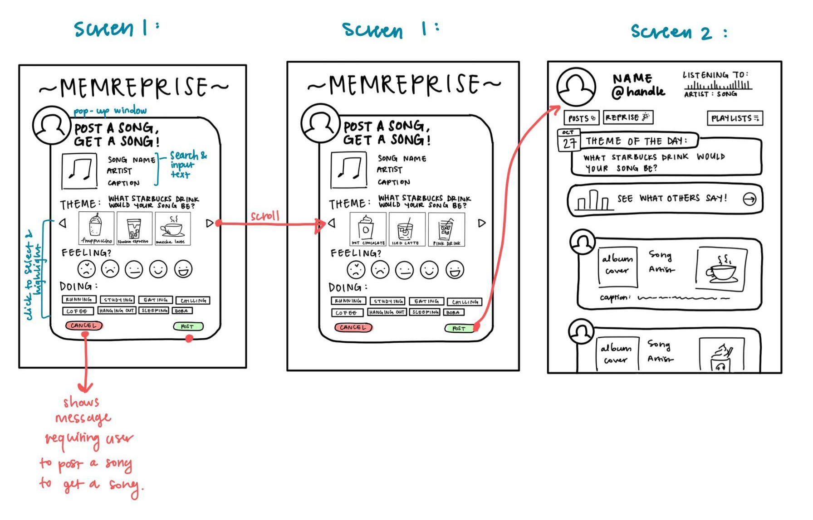
Low-Fi Simple Sketch: Share a song on MemReprise
Features:
Scroll arrows for the theme question options.
Select & highlight feature to show user’s choice.
Post button leads to home page feed.
Cancel button closes the post draft.
Notes:
Add features that are accessible in the relevant task

Slide 20
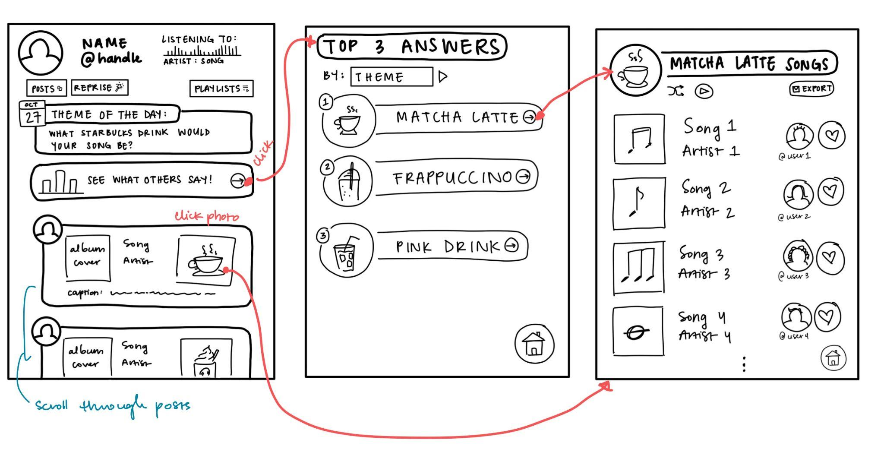
Low-Fi Moderate Sketch: Discover music from other users
who have similar music associations.
Features:
Arrow button opens Top 3 Answers per category.
Button on theme photo links to themed playlists.
Category Swipes helps users view Top 3 Lists for different categories.
Scroll through songs posted by other users.

Slide 21
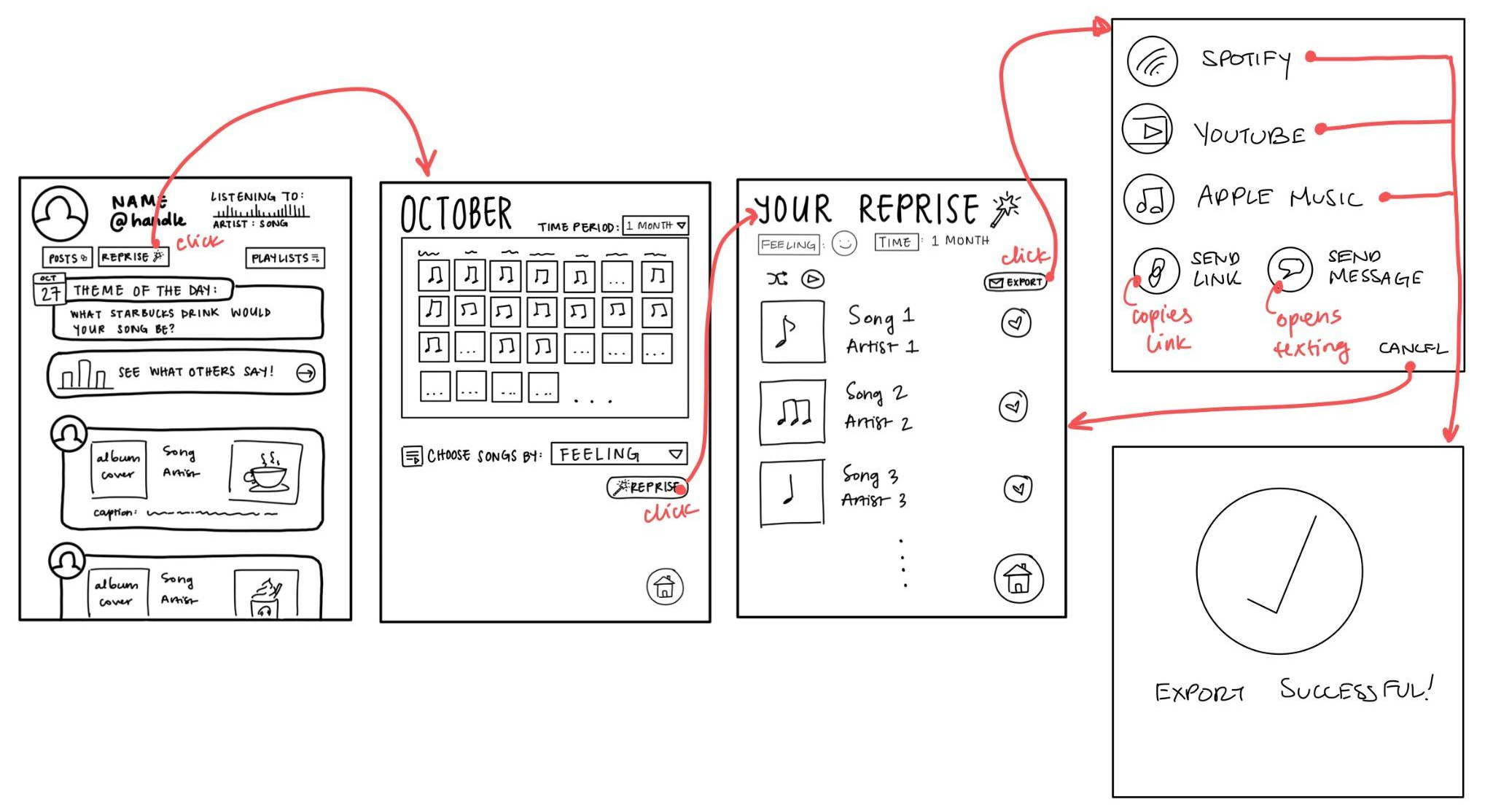
Low-Fi Complex Sketch: Create a personalized playlist
from songs you recently shared.
Features:
Reprise button in home page opens post history.
Dropdown allows user to filter post history.
Reprise button on history page generates playlist.
Export button opens links to save playlists on other streaming apps.
Home button to return to the home page.
Cancel button stops export.

Slide 22
Usability Goals
05

Slide 23
Usability Goals + Measurements
App Efficiency
User Satisfaction
KPI: monitored time to complete each assigned task
KPI: collected user satisfaction ratings + verbal feedback
Robustness
KPI: tracked error rates with points of failure or confusion
KPI = Key Performance Indicator

Slide 24
Progress toward Goals
App Efficiency
User Satisfaction
Easier to navigate with streamlined flows and simplified interface
Enhanced design aesthetics and functionality
Robustness
Improved error handling and clearer instructions

Slide 25
Major Design Changes
06

Slide 26
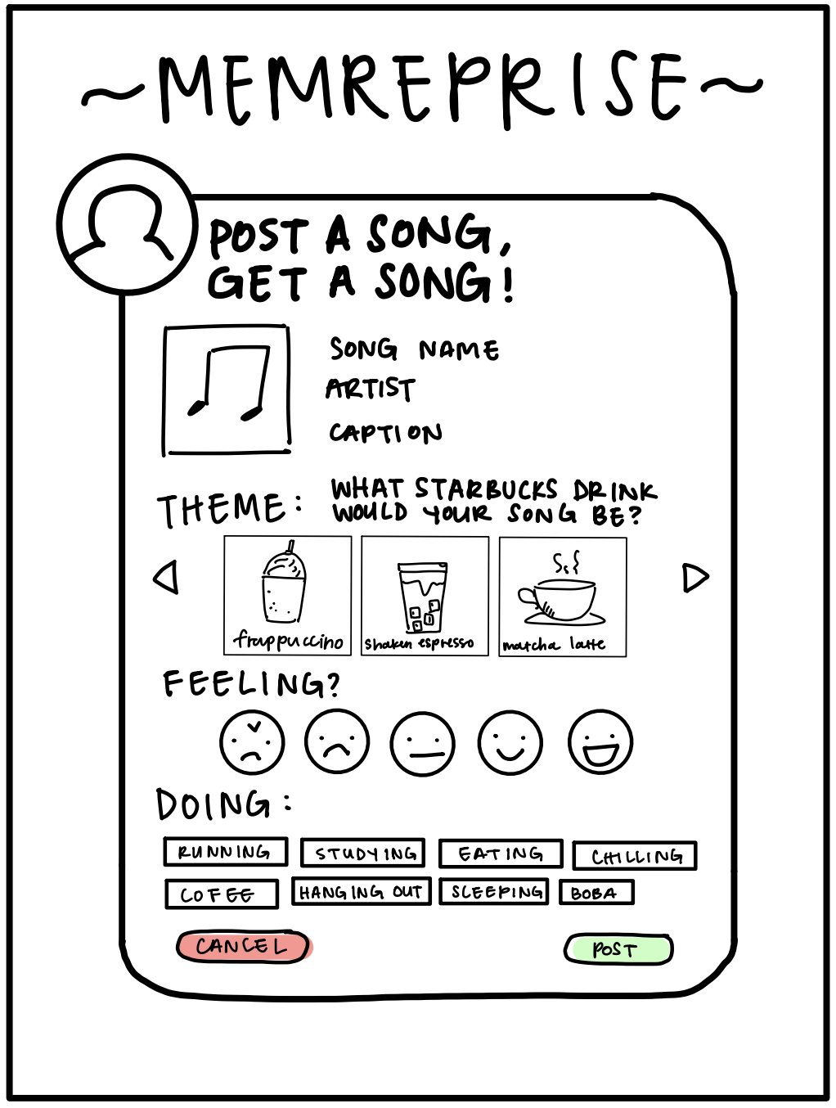
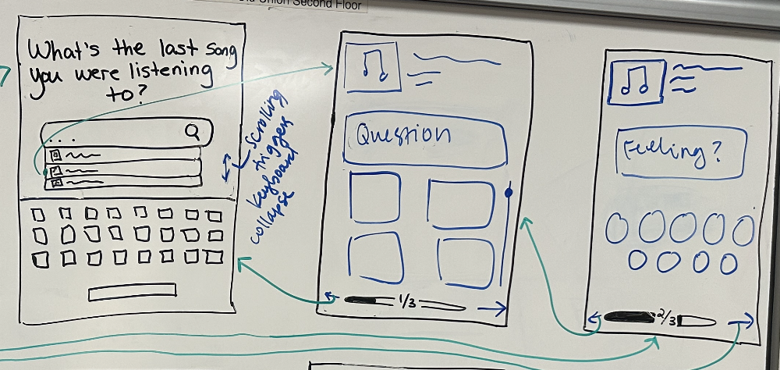
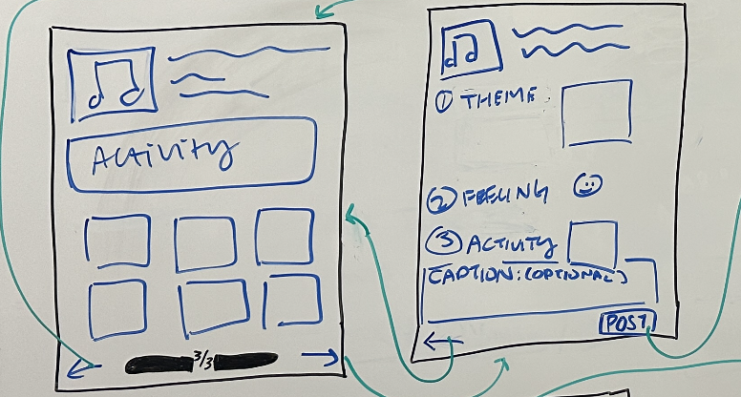
Change #1: “Post a Song” Draft
Before:
After:
Post draft components were all on one page
Post draft separated into multiple screens
Notes:
Breaking up “creating a post” into multiple steps and providing a post summary at the end
users were confused about what they were looking at, was not clear that the theme pic and feelings + activity were part of the song post.

Slide 27
Change #1: “Post a Song” Draft
Revised Design
Feedback:
Benedict: “Right now, I would be looking at a share icon” this inferred to us that the users were not clear on how to share a post when it was all together
Clare: Wanted to exit out of the screen at the beginning because they were unsure about whether they start off at a post draft or if they had to navigate to a “start post” button
Change: Each section of the post is now shown on a separate screen instead of all sections on one screen.
Rationale: Allows users to process each question individually and without being overwhelmed from too much information on one screen.
Post draft separated into multiple screens
Notes:
Breaking up “creating a post” into multiple steps and providing a post summary at the end
users were confused about what they were looking at, was not clear that the theme pic and feelings + activity were part of the song post.

Slide 28
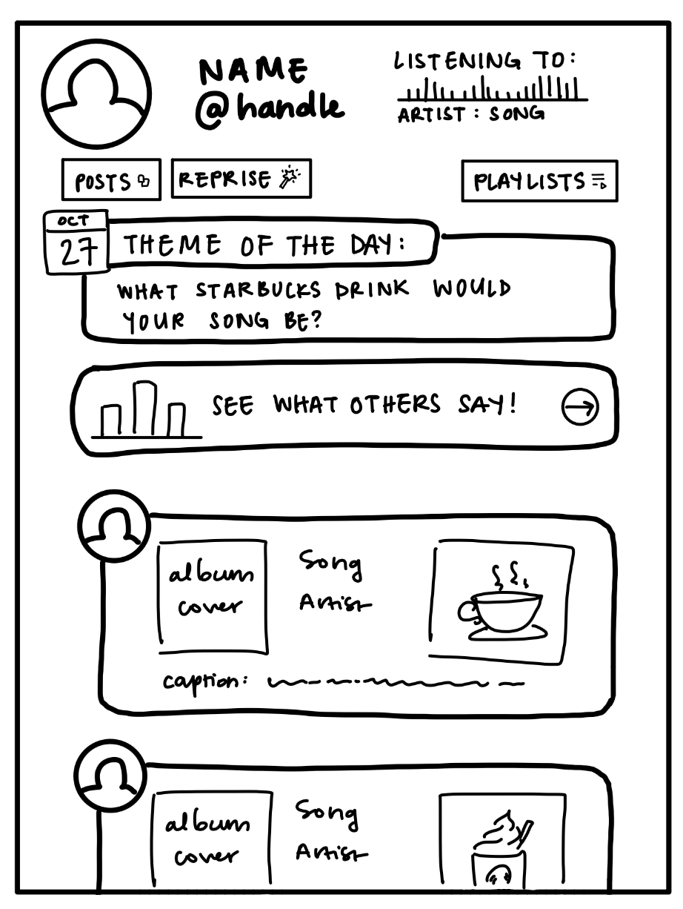
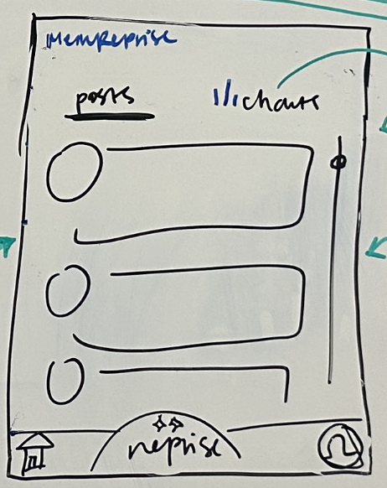
Change #2: Home Screen and Main Feed
Before:
After:
Multiple feeds and links on home screen
Different tabs for different feeds
Notes:
Reconstructing home/feed page into tabs for posts and charts
users were unsure about whether they are looking at their own posts or other users’ posts, charts is a clearer way to

Slide 29
Change #2: Home Screen and Main Feed
Feedback:
Clare: “Am I looking at my own posts? Or are these other users’ posts?”
Adrian: “Create a playlist from my own posts… where are my own posts?”
Change: We created link between the posts and charts by assigning them to distinct feed screens, accessible through separate tabs to maintain a clear distinction. We also isolated the user's profile and introduced a Reprise' button in the bottom navigation bar.
Rationale: During low-fi testing, it was unclear where users find their past posts. Users were also overwhelmed with the home page which had too many buttons and links without clear grouping. We addressed feedback by grouping functions into tabs and a nav bar.
Revised Design
Different tabs for different feeds
Notes:
Reconstructing home/feed page into tabs for posts and charts
users were unsure about whether they are looking at their own posts or other users’ posts, charts is a clearer way to

Slide 30
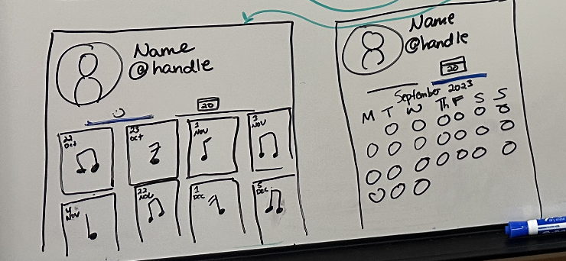
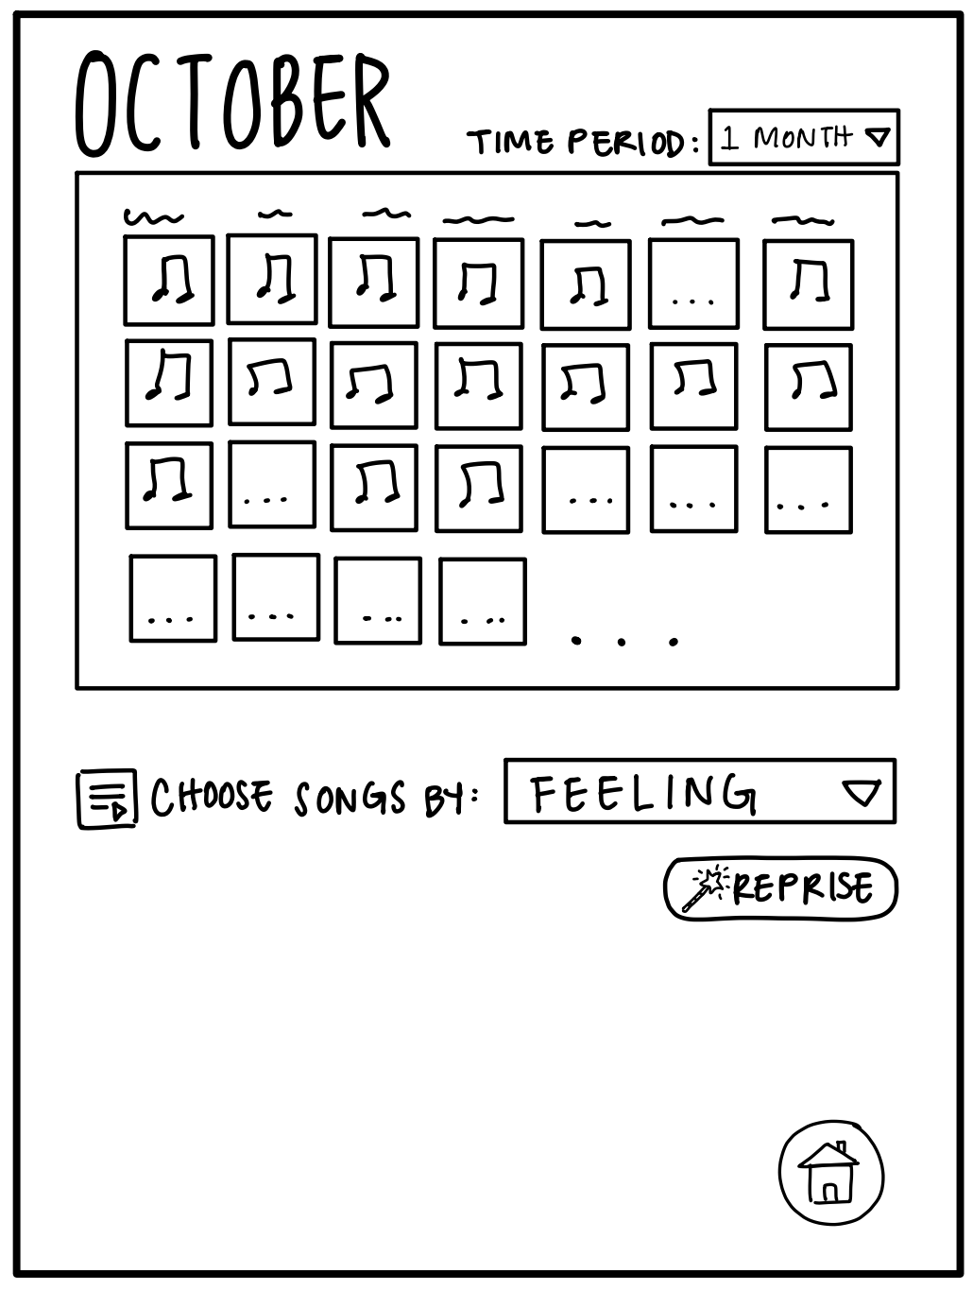
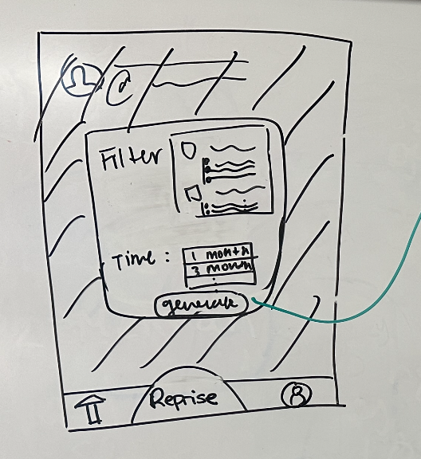
Change #3: User Profile and Reprise
Before:
After:
Calendar shows past shared songs and filter options.
Clear flow where users can access calendar from own profile. Separated post history and reprise.
Notes:
Separating calendar and reprise
Users were confused about where to find their own posts —> created a personal calendar in user profile
Reprise is its own button, separate from the calendars, and will automatically lead users to filtering options for their reprise playlists

Slide 31
Change #3: User Profile and Reprise
Feedback:
Benedict: “Not sure where to go from this part, either post or playlist”
Adrian: “I wonder what Reprise does”
Clare: She did not notice the filtering options when shown post history and she exited the screen without creating a playlist.
Change:
Separated user’s view of past music by keeping it in the profile tab. Users can also view past music in the activity tab or calendar tab
Reprise is its own tab, allowing users to filter songs based on time and category
Rationale: Differentiating "profile" for shared posts and "reprise" for playlist creation enhances user clarity on each section's function.
Revised Design
Clear flow where users can access calendar from own profile. Separated post history and reprise.
Notes:
Separating calendar and reprise
Users were confused about where to find their own posts —> created a personal calendar in user profile
Reprise is its own button, separate from the calendars, and will automatically lead users to filtering options for their reprise playlists

Slide 32
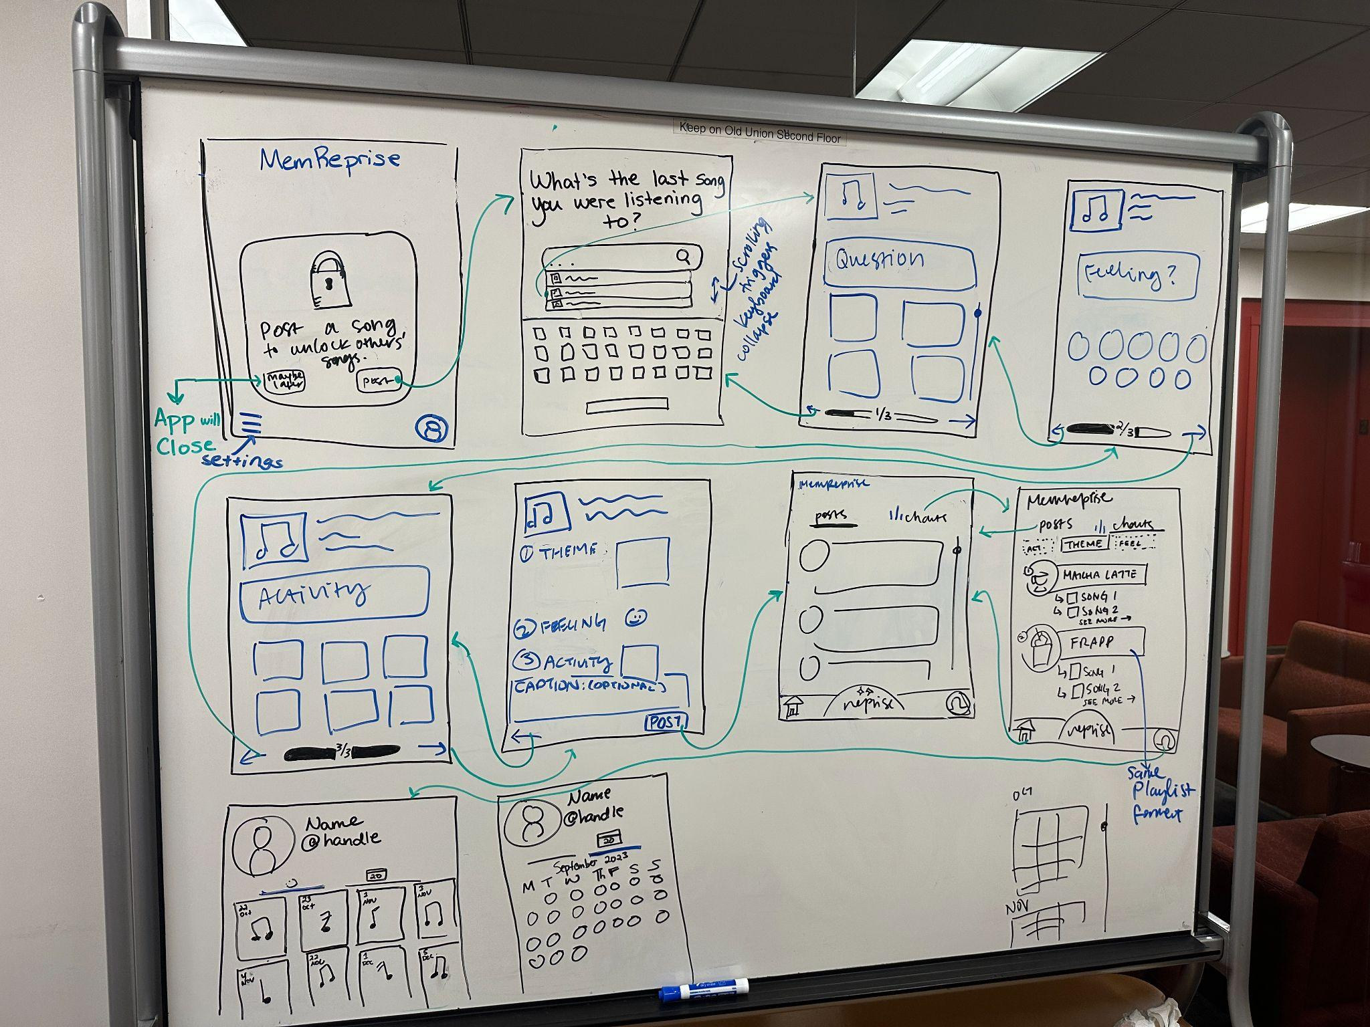
Changes Made
Changes:
Lock Screen: Intro screen will have a lock, user will post a song or do it later (app closes)
3 Steps: User fills in their post with 3 sequential steps
NavBar: Navbar at the bottom of the app
User Archives: Users can see past posts through their activity tab

Slide 33
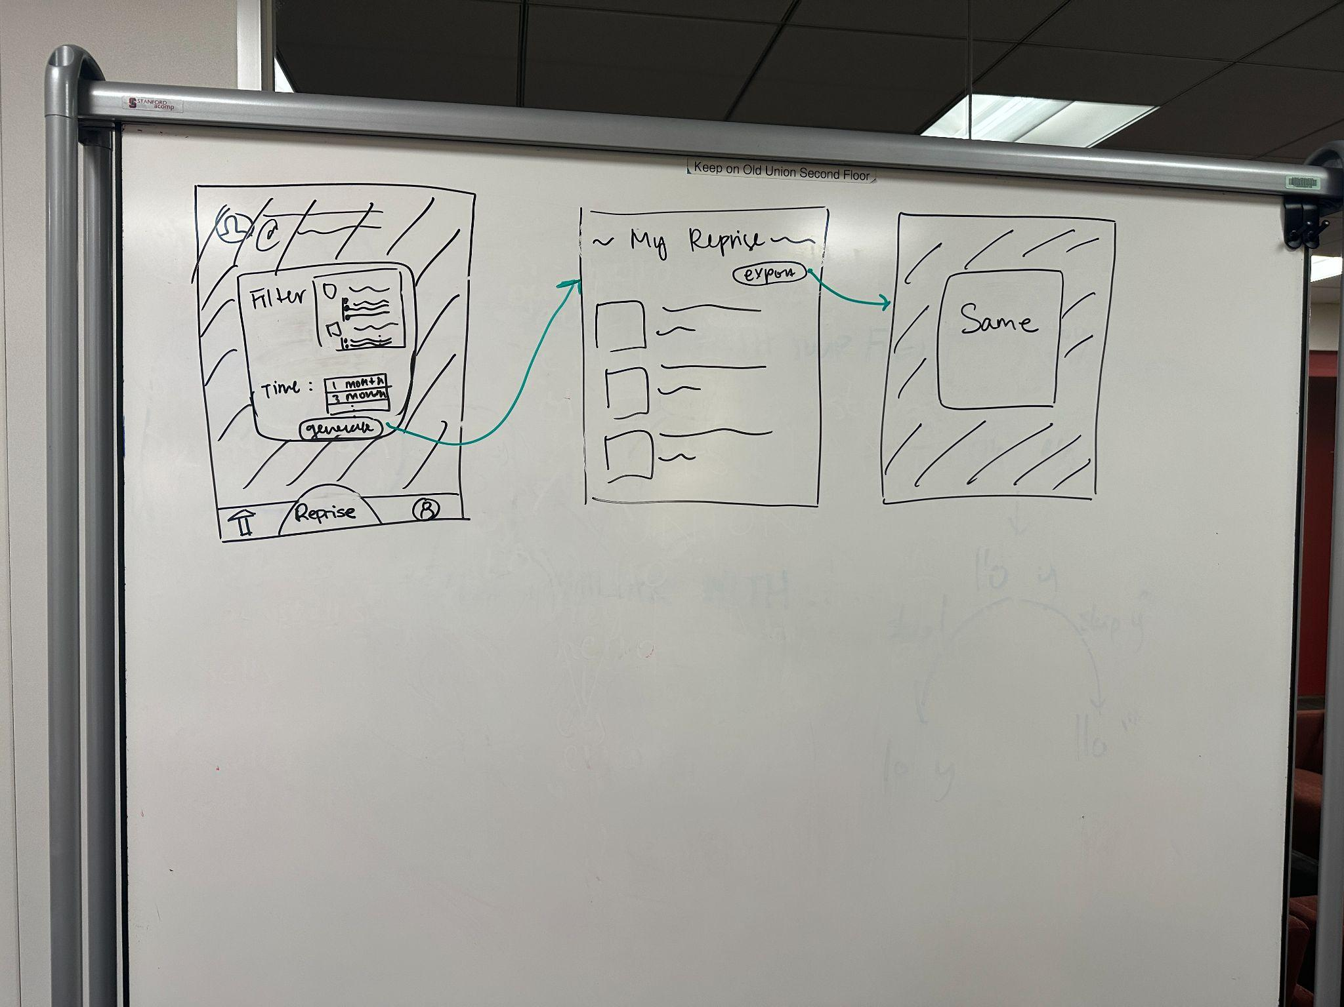
Changes Made
Changes:
Filter: Users can filter posts by category and time

Slide 34
Medium-Fi Task Flows
07

Slide 35
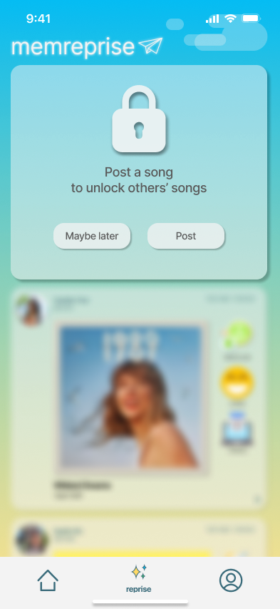
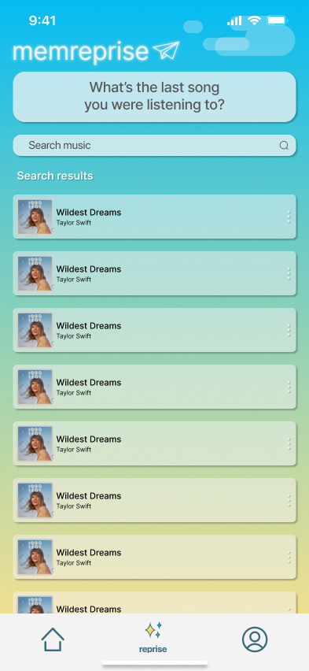

Search Up Song

Slide 36
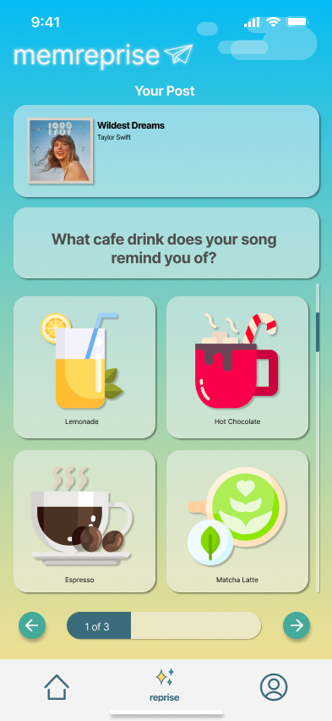
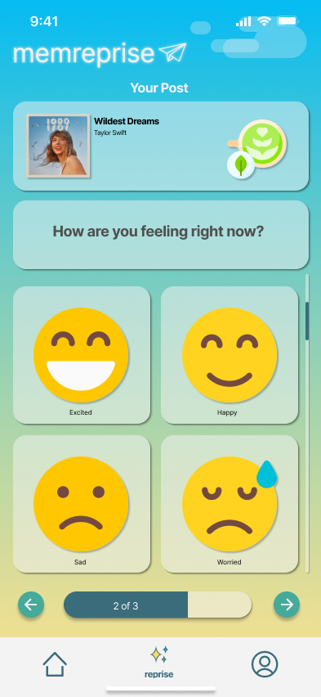
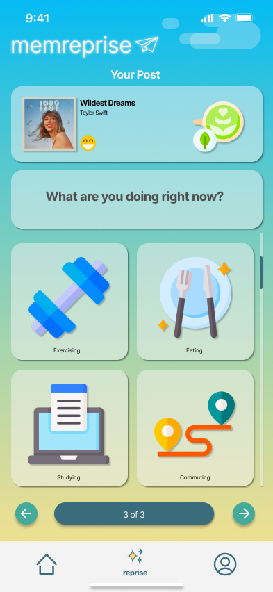
Personalize Post

Slide 37
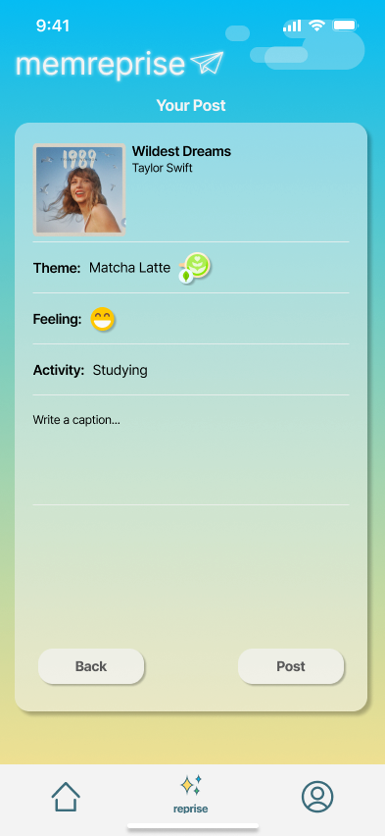
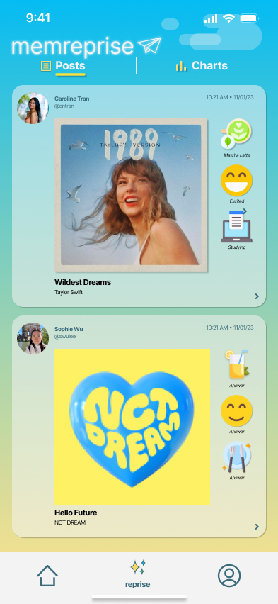
Finalize Post

Slide 38


Simple: Post a song on MemReprise
Tap “post” button to begin creating a post. Users are not allowed to see other users’ posts until they post something themselves.
Tap the search bar to start searching for your last listened to song.
Results will begin to populate as you type. Tap the correct result to move onto the next step.

Slide 39



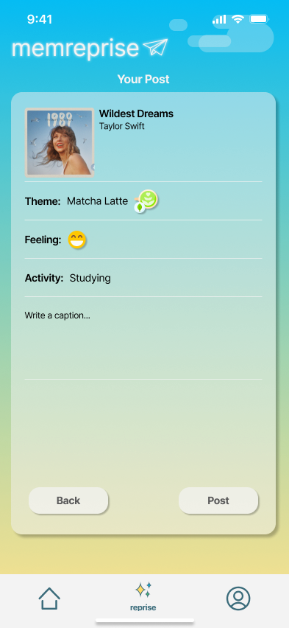
Simple: Post a song on MemReprise
For all selections, users can scroll to see more choices.
Answer a themed “question of the day” by tapping on the selection that best matches your song. Tap on the “next” arrow to advance.
Tap on the selection that best matches your current mood.
Tap on the selection that best matches your current activity.
The user sees an overview of their post. You can optionally choose to write a caption here.

Slide 40
Simple: Post a song on MemReprise
When satisfied with your post’s content, tap the “post” button
You are automatically taken to a feed where you can scroll and see all other users’ posts.

Slide 41
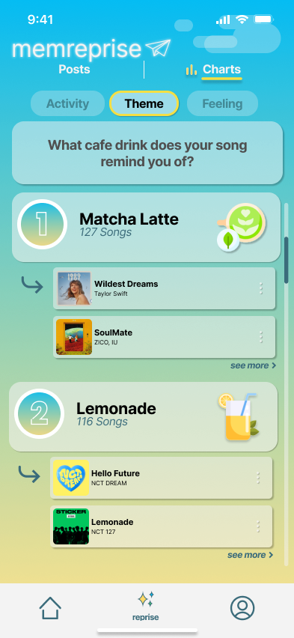
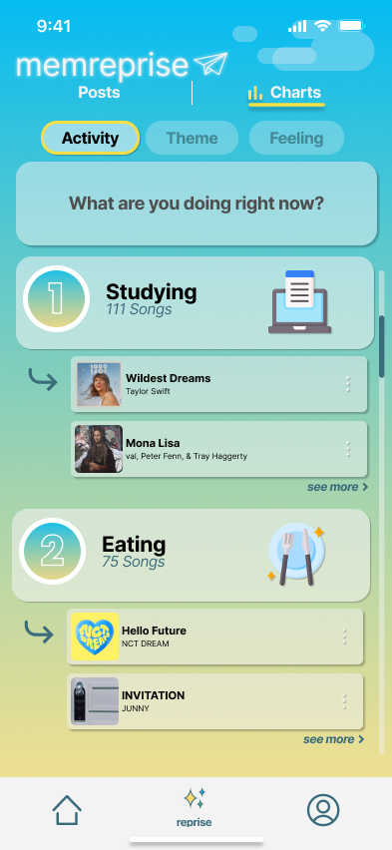
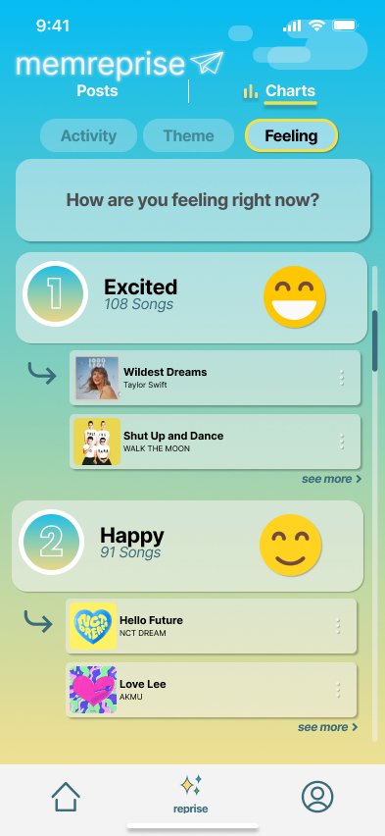
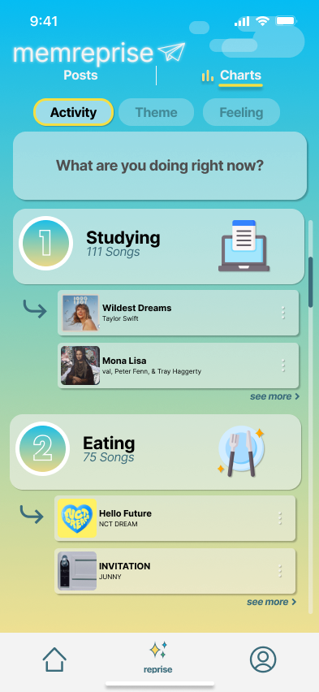
Moderate: Discover music from other users
who have similar music associations
Tap on the “Charts” tab to view the top associations other users have with their songs.
The “Charts” tab defaults to showing the most popular answers to the themed question of the day.
Tap the “Feeling” button to view the most commonly reported moods and the songs associated with them.
Tap the “Activity” button to view the most commonly reported activities and the songs associated with them.

Slide 42
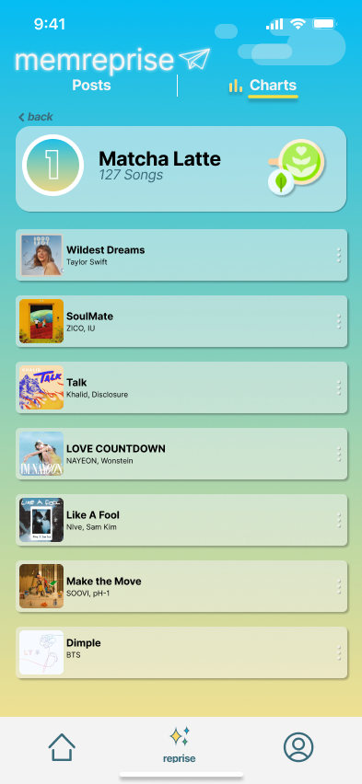
Moderate: Discover music from other users
who have similar music associations
To view other songs users have associated with the top answers, tap the “see more” button.
Tap “back” to return to the “Charts” tab.
View a playlist containing music from other users who have all associated their songs with the selected answer.
Scroll down to view more.

Slide 43
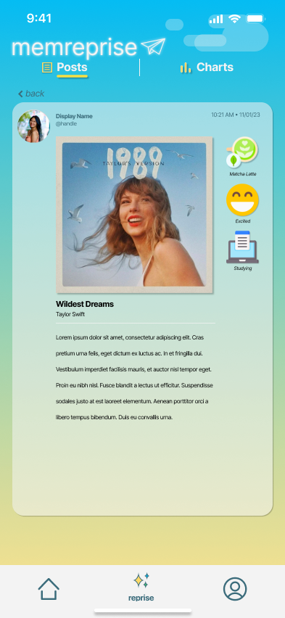
Moderate: Discover music from other users
who have similar music associations
Tap the “expand” arrow to view the post’s caption and any additional associations or memories that a user may have written into their caption.

Slide 44
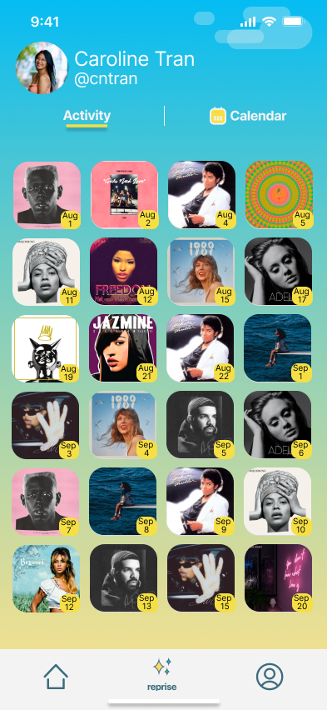
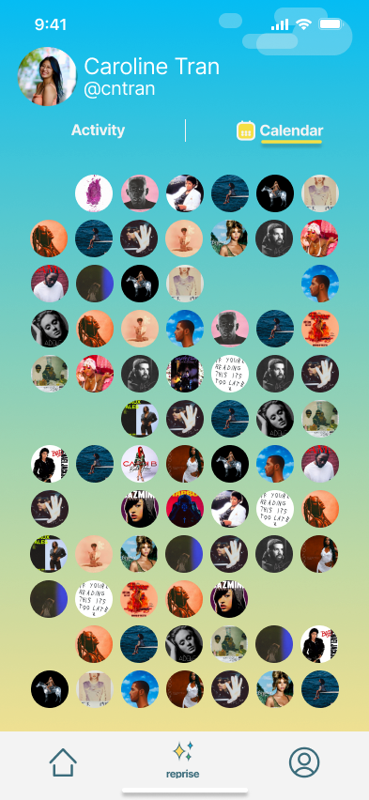
Complex: Create a personalized playlist
from songs you recently shared.
Tap the “profile” icon to see your user profile.
The profile defaults to your recent activity, which displays which songs you posted on which days.
Tap the “Calendar” tab to view your activity in a calendar format.

Slide 45
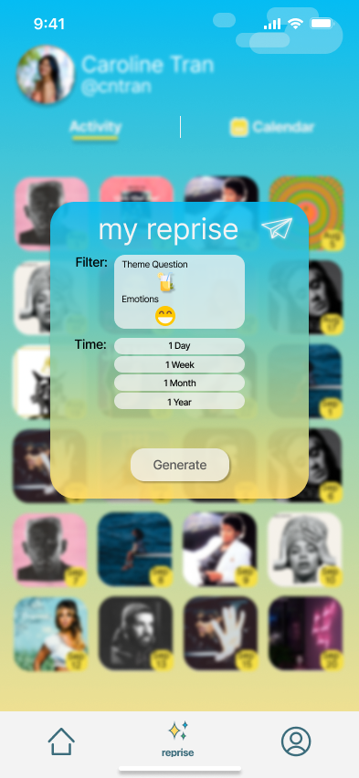
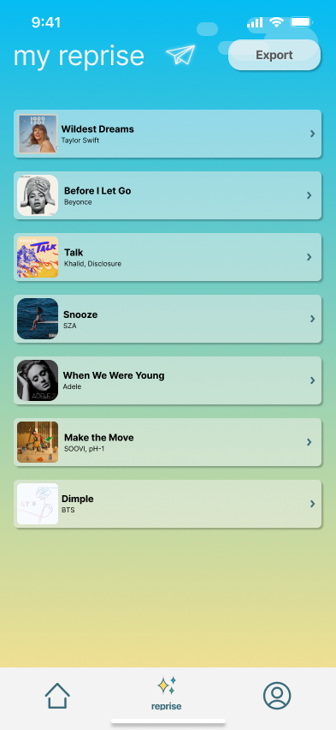
Complex: Create a personalized playlist
from songs you recently shared.
Note: the “reprise” functionality can be accessed from any screen after the user posts by tapping the “reprise” button. The pop-up will show up over the user’s current screen, and is demonstrated here over the “Activity” screen for simplicity.
Tap on the “reprise” button to begin creation of a personalized playlist.
Select how you want to filter which songs will go in your reprise playlist and the time period it should cover. Then tap “generate”.
The user will then see their reprise playlist, with all songs that meet the filter criteria.

Slide 46
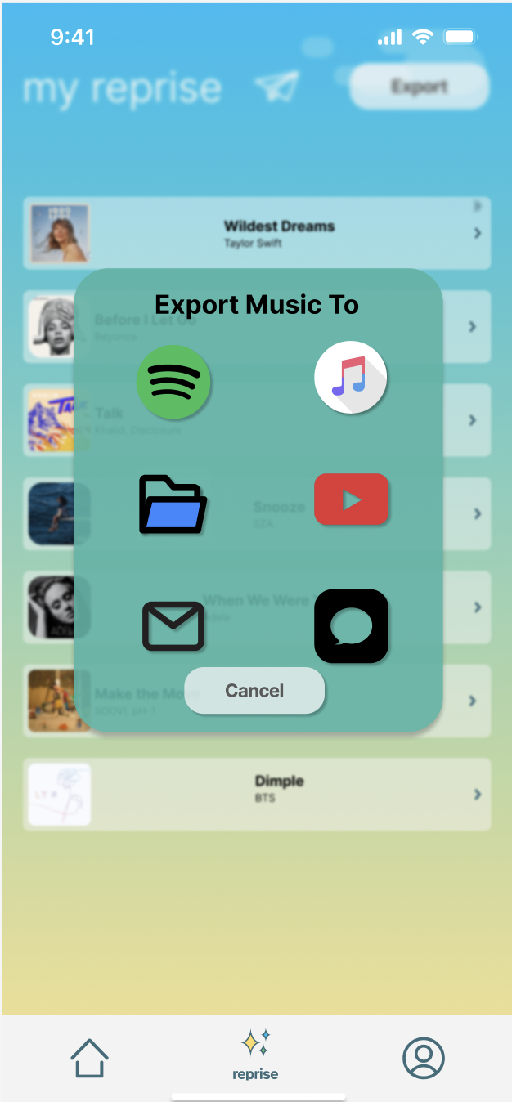
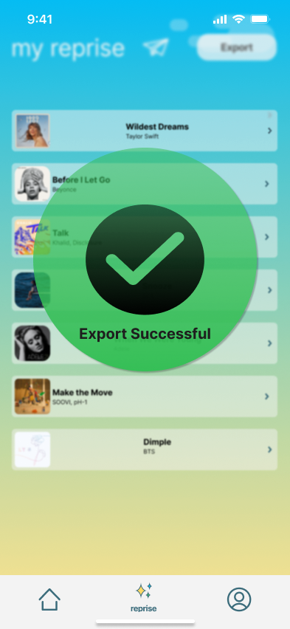
Complex: Create a personalized playlist
from songs you recently shared.
Tap on the export button to begin exporting your reprise playlist.
Select which platform you want to export your playlist to.
The user will then see whether the export has been successful.

Slide 47
Implementation
08

Slide 48
Tools (Figma + IconDuck)
Pros
Cons
Real-time collaboration
User-Friendly Interface
Extensive Library
  Many templates and design tools (IconDuck)
Interactive Prototypes
  dynamic, clickable prototypes = better simulation
Learning Curve
  Full Figma proficiency requires time
Consistency
  Collaborative design consistency is hard with many elements and interactions
Notes:
Central hub for a user’s important music and memories—stays true to archival goal
Direct user interaction (i.e. cong to each others memories, commenting on each others posts, linki
Feels like a chore to post
Potentially not novel enough—too similar to other apps

Slide 49
Limitations
Accessibility Testing
Live Data Integration
No built-in tools for comprehensive accessibility testing, crucial for inclusive designs
No real-time data or dynamic content because Figma cannot natively integrate live databases/APIs
Custom Code Execution
Limited simulation of logic/functions
User selections and actions across different screens are not preserved
Notes:
Note: (5-13 min) some participants took longer because they were thinking aloud more, not necessarily because
it was difficult for them
Relevant Observations: Buttons vs. tabs confusion

Slide 50
Hard-coded Features
Wizard-of-Oz Features
Music Libraries
  Limited selection of songs and playlists
Theme/Mood/Activity
  Set categories for users to choose from
Static User Profiles/Content:
  User info and post content stay unchanged
Simplified Music Search
  Bypasses search functionality with predetermined set of search results
Assisted Selection Inputs
  Options chosen by facilitator, simulating app response to inputs
Notes:
Manual simulation of dynamic responses
Requires behind-the-scenes operator during testing
Effective for real-time interaction illusionAssociations—memory, emotions

Slide 51
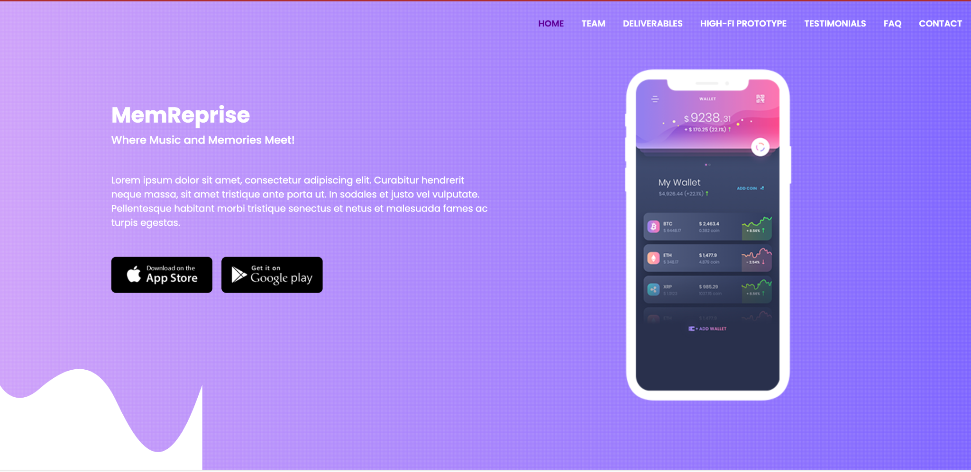
Check out our website!
http://web.stanford.edu/class/cs147/projects/HarmoniousTies/MemReprise/

Slide 52
Appendix
Link to the medium-fi prototype on Figma
  Medium-Fi Prototype File
  Medium-Fi Prototype
Link to the low-fi prototype in Google Drive
  Low-fi prototype

Slide 53
Thank
You!

